Slide 1
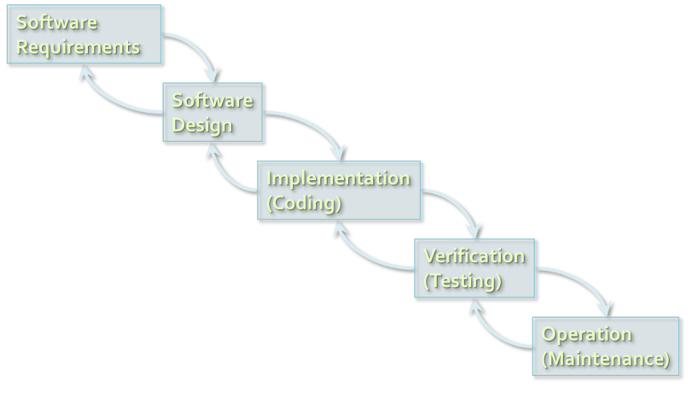
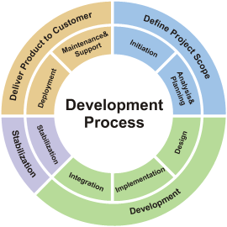
Software Development Models
Methodologies for Organizing the Software Development Process
Lora Borisova
QA Engineer
Web & Creative Assets Team
Telerik QA Academy

Slide 2


Table of Contents
Software Development Models
The Waterfall Development Process
V-model (Sequential Development Model)
Iterative-incremental Development Models

Slide 3

Table of Contents (2)
Software Development Models
Test Driven Development
Extreme Programing
Lean development
SCRUM

Slide 4
What is a Development Model?
A development model (methodology) is a set of practices and procedures for organizing the software development process
A set of rules that developers have to follow
A set of conventions the organization decides to follow
A systematical, engineering approach for organizing and managing software projects

Slide 5
Software Development Lifecycle Stages
Documentation of user requirements
Designing a software product
Implementing the software product
Testing the software solution
Deployment of the solution
Maintenance of the product

Slide 6



The Waterfall Development Process

Slide 7


The Waterfall Process
The waterfall development process:
Software
Requirements
Software
Design
Implementation
(Coding)
Verification
(Testing)
Operation
(Maintenance)
Notes:
It’s only in testing that your design is tested against reality. At this point you always learn something about your design (usually that it is wrong!), and that tells you something about your requirements (ditto!)

Slide 8

The Waterfall Model
The first fundamental model was the Waterfall model
Impressively simple and very well known
Only when one development level is completed will be initiated the next one
Only between adjacent levels are there feedback loops and revisions of the previous level
Emphasis is on documentation
Testing is understood as a "one time" action at the end of the development

Slide 9
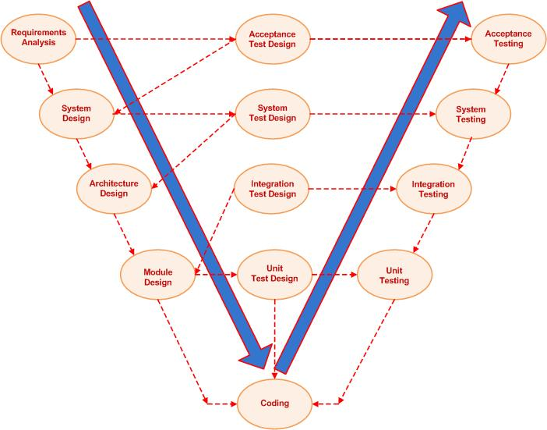
V-model
(Sequential Development Model)

Slide 10
The General V-model
The model presents two branches:
Development tasks
The process of design and implementation
Testing tasks
Verification and integration into bigger subsystems
Both are corresponding activities of equal importance

Slide 11
The V-model Scheme
Requirements
definition
Acceptance
test
Functional
system design
System
test
Technical system
design
Integration
test
Component
design
Component
test
Implementation &
Integration
Programming
Verification &
Validation

Slide 12
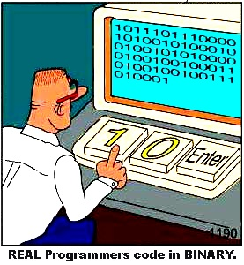
Development Tasks
Requirements specification
Specifying customer requirements
Defining the system’s purpose, characteristics and features
Functional system design
Mapping functions and dialogues of the new system

Slide 13

Development Tasks (2)
Technical system design
Designing the implementation of the system
Defining interfaces to the system environment
Decomposing the system into smaller understandable subsystems
System architecture

Slide 14

Development Tasks (3)
Component specification
Defining each subsystem
Task, behavior, inner structure, interfaces
Programming
Implementing each specified component in a programming language
Modules, units, classes

Slide 15

Testing Tasks
Component (unit) test
Verifies each software component
Does it perform correctly
According to its specification
Integration test
Checks groups of components
Do they collaborate correctly
According to the technical system design

Slide 16


Testing Tasks (2)
System test
Verifies the system as a whole
Does it meet the specified system requirements
Acceptance test
Does the system meet the customer requirements

Slide 17

Levels of Abstraction
Testing follows the levels of abstraction of development
The easiest way to find mistakes
Look for them on the same level of abstraction
On which they are produced
Testing is performed in parallel with development

Slide 18

Validation and Verification
Are we building the right system?
Does the product (or a part of it) solve its task?
Is this product suitable for its intended use?
Are we building the system right?
Does the product meet its specification?
Has it been achieved correctly and completely

Slide 19
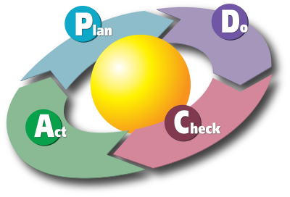
Iterative-incremental Development Models

Slide 20
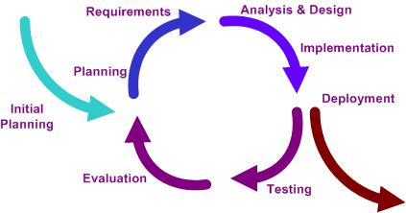
Iterative and Incremental Development
The basic idea behind these methods:
Develop a system through repeated cycles (iterative)
Smaller portions at a time/cycle (incremental)
Learn during development of previous parts or versions of the system
Plan-do-check-act cycle

Slide 21

Advantages
Regression testing
Increasingly important on all iterations after the first one
Verification and validation
Can be carried out on each increment
Take advantage of what was learnt
Product update at each iteration

Slide 22

Disadvantages
Tempts you to start coding before you have a clear idea of what you want to do
Not appropriate for small projects
The project can get stuck in a loop

Slide 23

Initialization Step
Creating a base version of the system
Create a product to which the user can react
Sampling of the key aspects of the problem
Solution that is simple enough to understand and implement easily

Slide 24
Iteration Step
Iteration step involves:
Design and implementation of a task from the project control list
Analysis of the current version of the system
Analysis of the structure, modularity, usability, reliability, efficiency & achievement of goals
Iteration analysis is based upon user feedback, and the program analysis facilities available

Slide 25

Project Control List
Project control list
Created to guide the iteration process
Contains a record of all tasks that need to be performed
New features to be implemented
Areas of redesign of the existing solution
Constantly revised as a result of the analysis phase

Slide 26
Iterative Development Phases
Incremental development slices the system functionality into increments (portions)
Each increment includes phases:
Inception
Identifies project scope, risks, and requirements (functional and non-functional) at a high level
Elaboration
Delivers a working architecture that mitigates the top risks and fulfills the non-functional requirements

Slide 27

Iterative Development Phases (2)
Each increment includes phases:
Construction
Incrementally fills-in the architecture with production-ready code
Transition
Delivers the system into the production operating environment

Slide 28

Iterative-incremental Models Examples
Examples for Iterative-incremental models
Agile Development
Rapid Application Development (RAD)
Rational Unified Process (RUP)

Slide 29

Agile Development
Notes:
Agile projects share certain characteristics (a backlog of work, self-organizing teams, rapid, incremental delivery of new functionality to users) that aren’t necessarily value-adding for all projects and under all circumstances.

Slide 30
What is Agile Development?
What is agile development?
A group of software development methodologies based on iterative and incremental development
Requirements and solutions evolve through collaboration between self-organizing, cross-functional teams
The new name of lightweight models
After the Agile Manifesto published in 2001

Slide 31

The Agile Manifesto
“Our highest priority is to satisfy the
customer through early and continuous
delivery of valuable software“
Manifesto for Agile

Slide 32
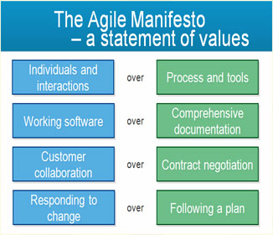
The Agile Manifesto
The four core values of Agile software development

Slide 33
The Agile Manifesto
Satisfying 'customers' through early and continuous delivery of valuable work.
Breaking big work down into smaller components that can be completed quickly.
Recognizing that the best work emerges from self-organizing teams.
Providing motivated individuals with the environment and support they need and trust them to get the job done.
Creating processes that promote sustainable efforts.
Maintaining a constant pace for completed work.
The 12 principles laid down in the Agile Manifesto

Slide 34
The Agile Manifesto
Welcoming changing requirements, even late in a project.
Assembling the project team and business owners on a daily basis throughout the project.
At regular intervals, having the team reflect upon how to become more effective, then tuning and adjusting behavior accordingly.
Measuring progress by the amount of completed work.
Continually seeking excellence.
Harnessing change for competitive advantage.
The 12 principles laid down in the Agile Manifesto

Slide 35

Agile Characteristics
Tasks are being broken into small increments with minimal planning
Do not directly involve long-term planning
Iterations are short time frames (time boxes)
Typically last one to four weeks.
Each iteration involves a team working through a full software development cycle
E.g. pair programming

Slide 36


Agile Characteristics (2)
Available release (with minimal bugs) at the end of each iteration
Teams are usually
Cross-functional
Self-organizing
Team members take initiative and responsibility

Slide 37
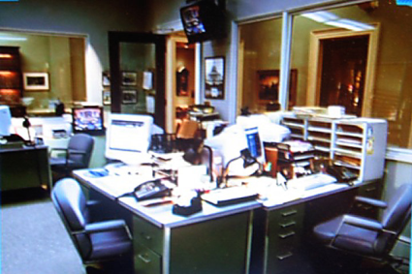
Agile Characteristics (3)
Face-to-face communication over written documents
Most agile teams work in a single open office (called a bullpen)
Team size is typically small (5-9 people)
Videoconferencing, voice, e-mail, etc. for teams not in the same location

Slide 38

Agile Characteristics (4)
Agile teams contain a customer representative
Answers mid-iteration problem-domain questions
At the end of each iteration participates in reviewing progress and re-evaluating priorities
Routine and formal daily face-to-face debrief meetings among team members

Slide 39
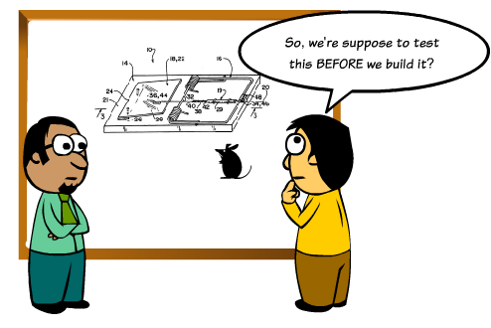
Test Driven Development
Tests First – Code Later

Slide 40

The Test Driven Development Cycle
Test-driven development (TDD) relies on the repetition of a very short cycle:
Write a failing automated test case
Defines a desired improvement or new function
Produce code to pass that test
Finally refactor the new code to acceptable standards

Slide 41
Development Cycle
Add a test
[Pass]
Run the tests
[Development
continues]
[Fail]
Write code/Refactor
[Fail]
Run the tests
[Development stops]

Slide 42
Advantages of TDD
TDD shortens the programming feedback loop
TDD provides detailed specification (tests)
TDD promotes the development of high-quality code
TDD provides concrete evidence that your software works
TDD helps to ensure that your design is clean by focusing on creation of operations that are callable and testable

Slide 43
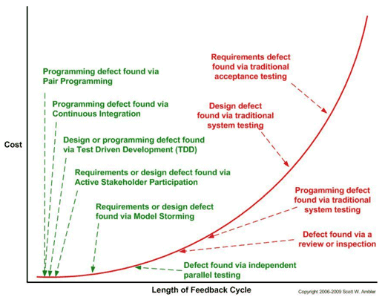
Disadvantages of TDD
Big time investment. For the simple case you lose about 20% of the actual implementation, but for complicated cases you lose much more.
Additional Complexity. For complex cases your test cases are harder to write.
Design Impacts. Sometimes the
design is not clear at the start
and evolves as you go along –
this will force you to redo your test.

Slide 44

Why Write the Test Before the Code?
Think through the requirement
Think about the design and usability of the API
There’s never time to write it afterwards
You write much less tests (if at all) otherwise

Slide 45
Why Make it Fail First?
Make sure the test does not have a bug
Make sure you’re testing the right thing
When the test passes, you are done
If you can’t write that test, than maybe you:
Do not understand the requirement
Have over designed things (not testable)
Do not have a small enough problem to solve

Slide 46
Why Refactor?
Constantly improve the design of the code
Remove duplication, improve readability and maintainability
You’ll need to when things change
Requirements, your understanding of them, other factors…

Slide 47

Agile Methodologies
eXtreme Programming (XP)
Scrum
Kanban
Lean
Crystal family of methodologies
Adaptive Software Development (ASD)
Dynamic System Development Model (DSDM)
Agile Unified Process (AUP)

Slide 48
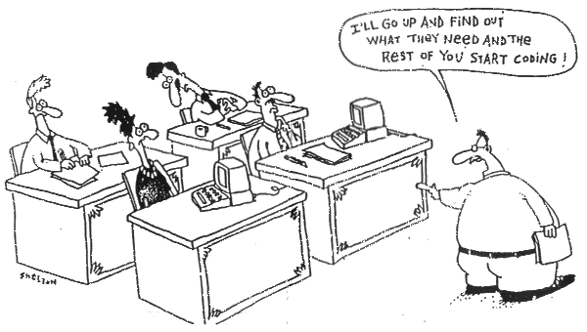
Extreme Programming

Slide 49
Extreme Programming
Extreme Programming (XP)
A type of agile software development
Intended to improve software quality and responsiveness to changing customer requirements
Advocates frequent "releases" in short development cycles (time boxes)
Intended to improve productivity
Checkpoints where new customer requirements can be adopted

Slide 50
Extreme Programming
Extreme Programming improves a software project development in five essential ways
Communication
Everyone is part of the team and communicates face to face daily
Simplicity
We will do what is needed and asked for, but no more

Slide 51
Extreme Programming
Feedback
We will talk about the project and adapt our process to it, not the other way around.
Respect
Everyone gives and feels the respect they deserve as a valued team member.
Courage
We will tell the truth about progress and estimates.

Slide 52
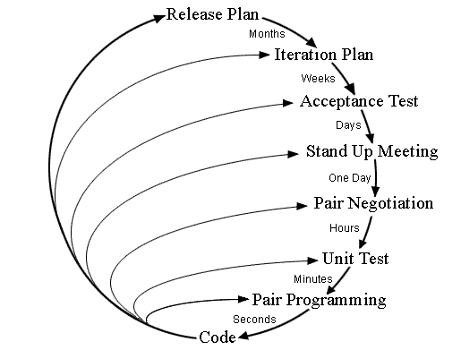
Planning / Feedback Loops
Planning and feedback loops in Extreme Programming

Slide 53
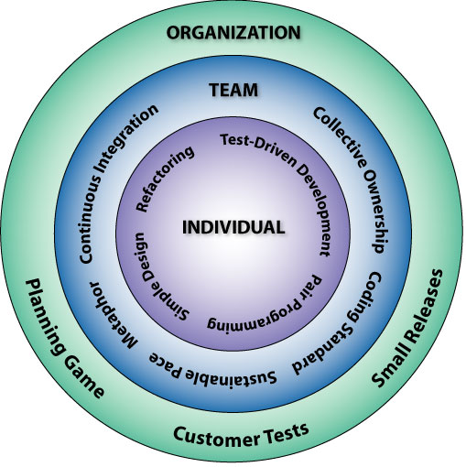
Extreme Programming: The 12 Key Practices
The Planning Game
Small Releases
Metaphor
Simple Design
Test-Driven Development
Refactoring
Pair Programming
Collective Ownership
Continuous Integration
40-Hour Workweek
On-site Customer
Coding Standards

Slide 54

Lean Development

Slide 55

Lean Principles
Eliminate waste
Unnecessary code and functionality
Delay in the software development process
Unclear requirements
Bureaucracy
Slow internal communication

Slide 56

Lean Principles (2)
Amplify learning
Speed up the learning process using short iteration cycles
Accumulation of defects is prevented by running tests as soon as the code is written
Gathering user requirements is simplified
Presenting screens to the end-users and getting their input

Slide 57

Lean Principles (3)
Decide as late as possible
Until decisions can be made based on facts
Not on uncertain assumptions and predictions
The more complex a system is, the more capacity for change should be built into it

Slide 58
Lean Principles (4)
Deliver as fast as possible
The sooner the end product is delivered, the sooner feedback can be received
The shorter the iterations, the better the learning and communication within the team
Speed assures the fulfilling of the customer's present needs
Not what they required yesterday

Slide 59

Lean Principles (5)
Empower the team
“Find good people and let them do their own job"
Managers are taught how to listen to the developers
People are not just resources
People need motivation and a higher purpose to work for

Slide 60

Lean Principles (6)
Build integrity in
Integrity means that the system’s separate components work well together as a whole
Refactoring is one of the healthy ways towards integral architecture

Slide 61

Lean Principles (7)
See the whole
Software systems are not simply the sum of their parts, but also the product of their interactions

Slide 62
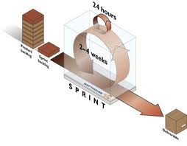
Scrum
Making Progress in Series of Sprints

Slide 63

Scrum
Scrum is an iterative incremental framework for managing complex projects
An agile process that allows us to focus on delivering the highest business value in the shortest time
It allows us to rapidly and repeatedly inspect actual working software (every two weeks to one month)

Slide 64

Scrum (2)
The business sets the priorities
Teams self-organize to determine the best way to deliver the highest priority features
Every two weeks to a month anyone can see real working software
And decide to release it as is or continue to enhance it for another sprint

Slide 65


Pigs and Chickens
Scrum teams consist of three core roles and a range of ancillary roles
Core roles are often referred to as pigs
They are fully committed to the project
Ancillary roles are referred as chickens
No formal role and infrequent involvement
Came into being after the story The Chicken and the Pig

Slide 66
Scrum Core Roles
The core roles in Scrum teams are those committed to the project in the Scrum process
They are the ones producing the product (objective of the project)
Scrum core roles:
Scrum Master – maintains the Scrum processes
Product Owner – represents the stakeholders
Team – a group of about 7 people
Manager – keeps the product vision clear

Slide 67
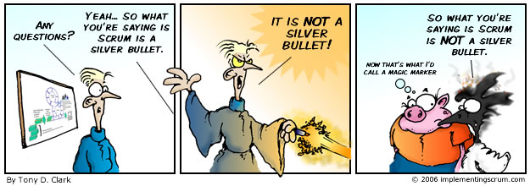
The Scrum Master
Scrum is facilitated by a Scrum Master
The Scrum Master is not the team leader
Acts as a buffer between the team and any distracting influences

Slide 68
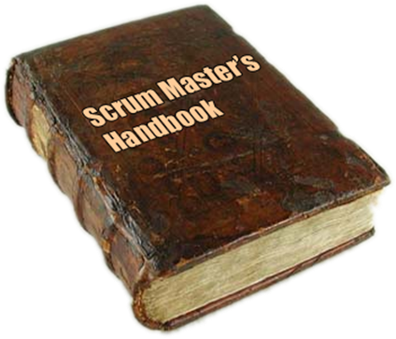

The Scrum Master
Accountable for removing impediments
Enforcer of rules
Protects the team and keep them focused on the tasks in hand
Also referred to as servant-leader

Slide 69

The Team
The Team is responsible for delivering the product
Typically made up of 5–9 people
Team members have cross-functional skills
The team does the actual work
Analyze, design, develop, test, technical communication, document, etc.

Slide 70

The Team (2)
Membership should change only between sprints
It is recommended that the Team be self-organizing and self-led
Although often works with some form of project or team management

Slide 71

The Product Owner
The Product Owner represents the voice of the customer
He is accountable for ensuring that the Team delivers value to the business
Writes customer-centric items (typically user stories)
Prioritizes them, and adds them to the product backlog

Slide 72

The Product Owner (2)
Accepts or rejects work results
Scrum teams should have one Product Owner
The product owner also can be a member of the Development Team
It is not recommended this role to be combined with that of Scrum Master

Slide 73
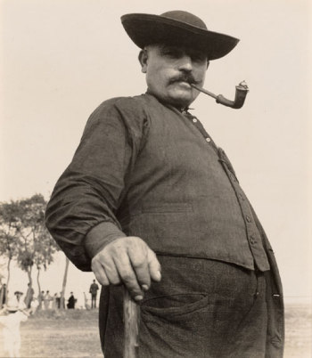
Scrum Ancillary Roles
Stakeholders (customers, vendors)
The people who enable the project
For them the project will produce the agreed-upon benefits, which justify its production
Directly involved only in the process during the sprint reviews

Slide 74

Scrum Ancillary Roles (2)
Managers (including Project Managers)
People who will set up the environment for product development
Responsible for keeping the product vision clear
Help for day-to-day problems resolving (out of Team scope)
Provide tools instead of solutions
Often the Scrum Master and the Manager are one and same person

Slide 75
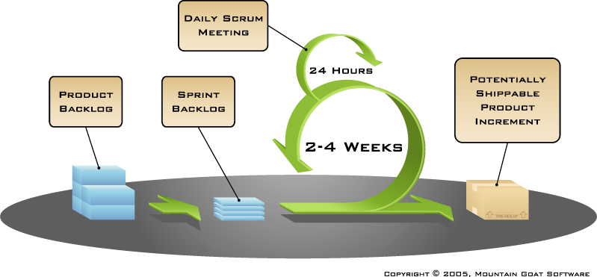
The Scrum Process Framework

Slide 76
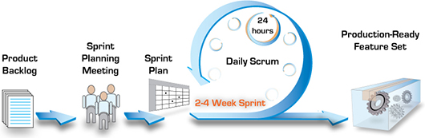
Scrum Terminology
Sprint/Iteration
An iteration in the Scrum development
Usually two to four weeks
Backlog
All features that have to be developed represented in User Story format
Burn down chart (Release and Sprint)

Slide 77

Product Backlog
A high-level list with broad descriptions of all potential features for the product (backlog items)
Maintained throughout the entire project ()
Prioritized by the product owner
Open and editable
In terms of years
The product backlog

Slide 78
A Sample Product Backlog
Backlog item | Estimate
Allow a guest to make a reservation | 3
As a guest, I want to cancel a reservation. | 5
As a guest, I want to change the dates of a reservation. | 3
As a hotel employee, I can run RevPAR reports (revenue-per-available-room) | 8
Improve exception handling | 8
… | 34
… | 55

Slide 79
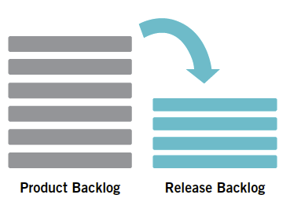
Release Backlog
Limited set of items from the Product Backlog that should be developed for a given release
Focused to specific goals identified for a specific time-frame
Reprioritized by the product owner
All items estimated at high level (story points)
In terms of months

Slide 80

Sprint Backlog
The list of work the team must address during the next sprint
Features are broken down into tasks
Between four and sixteen hours of work
Tasks on the sprint backlog are never assigned
In terms of weeks
The sprint backlog

Slide 81
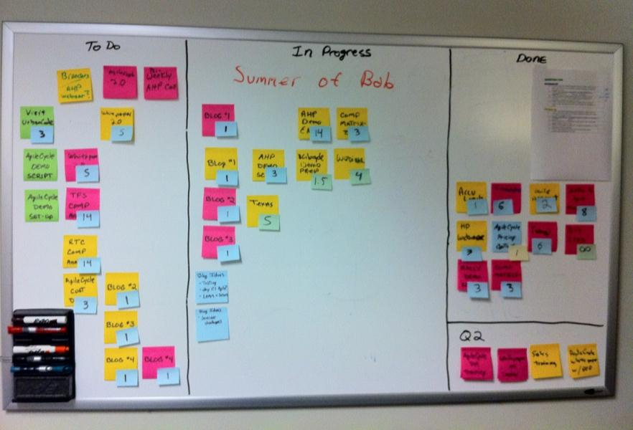
Sprint Backlog (2)
Often an accompanying task board is used to see and change the state of the tasks
Labels are used like “to do”, “in progress” and “done”

Slide 82
A Sample Sprint Backlog
Backlog item | Status | Day 1 | Day 2 | Day 3 | Day 4 | Day 5
Code the user interface | Completed | 20 | 10 | 0 | 0 | 0
Code the middle tier | Not Started | 8 | 8 | 8 | 8 | 8
Test the middle tier | In Progress | 24 | 20 | 30 | 25 | 20
Write online help | Completed | 12 | 12 | 12 | 12 | 0
Write the foo class | Completed | 12 | 0 | 0 | 0 | 0
Add error logging | Not Started | 8 | 8 | 8 | 8 | 8

Slide 83
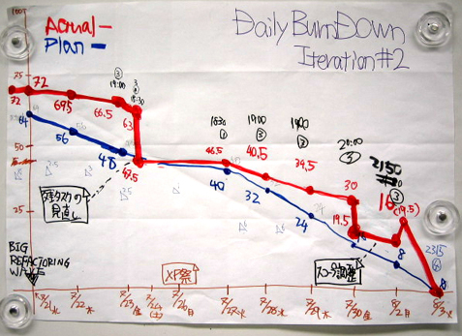
Sprint Burn Down Chart
The sprint burn down chart is a publicly displayed chart
Shows remaining work in the sprint backlog
Updated every day, it gives a simple view of the sprint progress

Slide 84
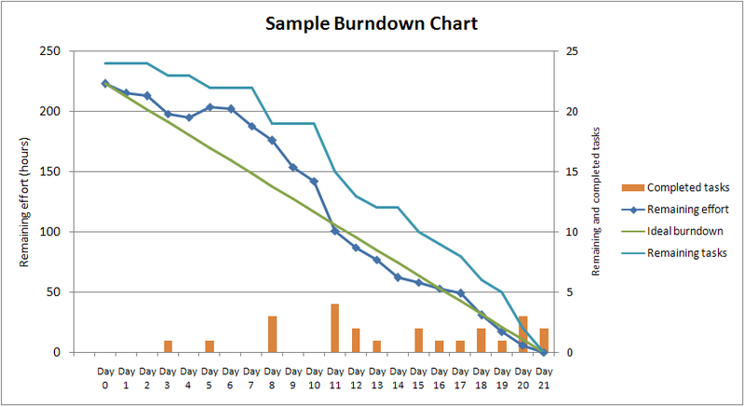
A Sample Burn Down Chart

Slide 85
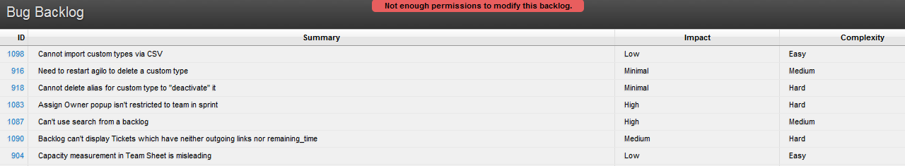
Bug Backlog
A type of backlog which includes bugs only
Can be part of the Product Backlog
Bugs are listed by their priority
Includes bugs reported by customers
Bugs are prioritized by Product Owner (may be supported by QA lead)

Slide 86

Team Backlog
Created by the Team
Represents leftover work that team should do
It’s a list of “want to do”, and not a commitment
Items can be estimated (preferable) or not
It has a single owner – the team’s Product Owner

Slide 87
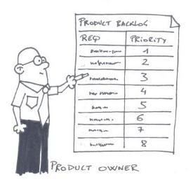
Scrum Practices
Sprint Planning Meeting
At the beginning of the sprint cycle
Establish the Sprint backlog
Daily Scrum stand-up meeting
Each day during the sprint – project status from each team member
Timeboxed to 15 minutes
Sprint Review Meeting
Review the work completed / not completed

Slide 88

Sprint Planning Meeting
Held at the beginning of the sprint cycle (every 7-30 days)
Team selects items from the product backlog they can commit to completing
Sprint backlog is created
Tasks are identified and each is estimated (1-16 hours)
Done collaboratively
Not alone by the Scrum Master

Slide 89
Sprint Planning Meeting (2)
Eight hour time limit
(1st four hours) Product Owner + Team:
Dialog for prioritizing the Product Backlog
(2nd four hours) Team only:
Hashing out a plan for the Sprint, resulting in the Sprint Backlog
Code the middle tier (8 hours)
Code the user interface (4)
Write test fixtures (4)
Code the foo class (6)
Update performance tests (4)
As a vacation planner, I want to see photos of the hotels

Slide 90

The Daily Scrum
Held each day during the sprint
Also called the daily standup
This meeting has specific guidelines:
The meeting starts precisely on time
All are welcome, but normally only the core roles speak
The meeting is time-boxed to 15 minutes
The meeting should happen at the same location and same time every day

Slide 91


The Daily Scrum (2)
Everyone answers 3 questions
1
What did you do yesterday?
2
What will you do today?
3
Is anything in your way?

Slide 92
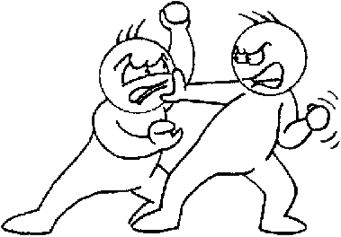
The Daily Scrum (3)
The Scrum meeting helps avoiding other unnecessary meetings
If a problem needs discussion – this can be done after the meeting

Slide 93

Sprint Review/Demo Meeting
Review the work that was completed and not completed
Present the completed work to the stakeholders (a.k.a. “the demo”)
New features or underlying architecture
Incomplete work cannot be demonstrated
2-hour preparation time rule
No slides
Four hour time limit

Slide 94
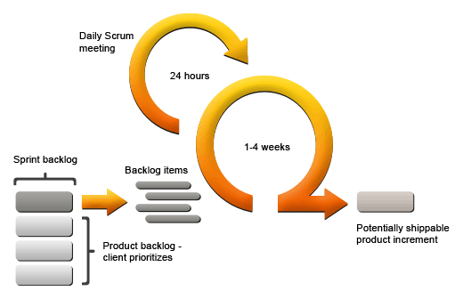
Sprint Retrospective
All team members reflect on the past sprint
Make continuous process improvements
Two main questions are asked
What went well during the sprint?
What could be improved in the next sprint?
Three hour time limit

Slide 95
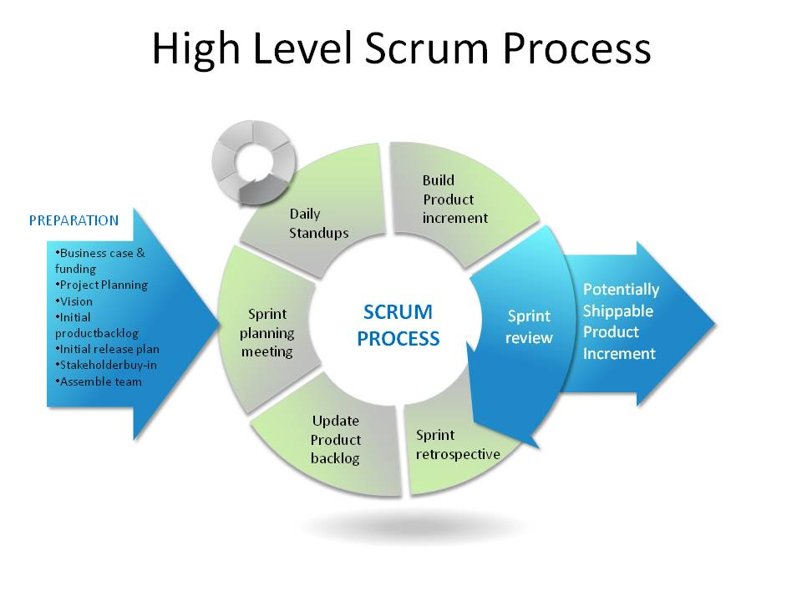
Scrum Levels

Slide 96
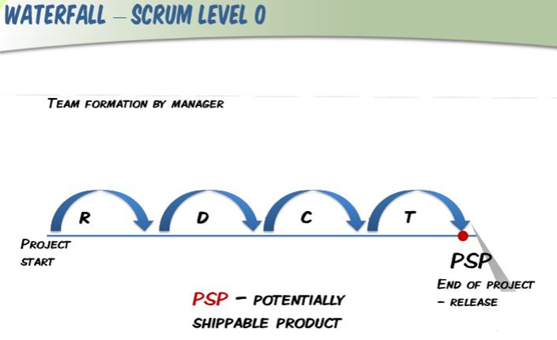
Scrum Level 0

Slide 97
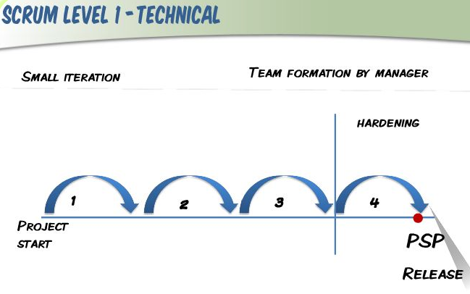
Scrum Level 1

Slide 98
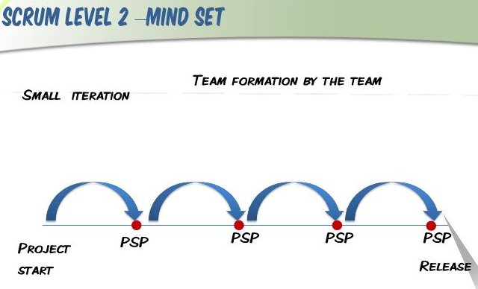
Scrum Level 2

Slide 99
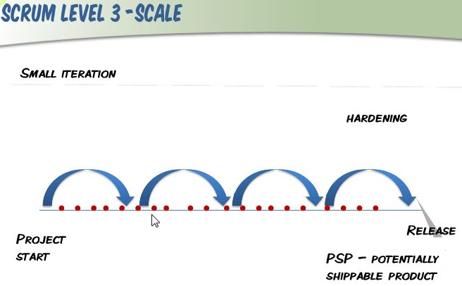
Scrum Level 3

Slide 100

Who Uses Scrum?
Telerik
Microsoft
Yahoo
Google
Electronic Arts
Lockheed Martin
Philips
Siemens
Nokia
IBM
BBC
Etc.

Slide 101
Software Development Models
?
?
?
?
?
Questions?
?
?
?
?
?
?

